Slide 1
Practice Lab:
This Practice Lab is dependent on Discussion Module 7443, where most of the objects we create in this lab were introduced.
This Practice Lab requires a working DSE system, with DSE Search enabled, and with ability to execute CQL DDL.
Because of the dependency on the dsetool utility, this Practice Lab requires a ssh(C) prompt on at least one node operating DSE Search. All other commands are run from CQLSH, or DSE Studio.
DSE Search, Create Synonym, Case Insensitive
Notes:
The goal of this Practice Lab is to create your first DSE Search index, one that eventually delivers case insensitive, synonym processing.
Runtime requirements are detailed in the slide above.

Slide 2
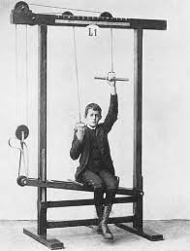
Challenge 1: Execute all of the following below
Discussion Module 7443 details each of the commands entered on the notes page below.
The dsetool command must be run directly on one of the DSE nodes running DSE Search, in an ssh(C) command window. All other commands may be run in CQLSH, or DSE Studio.
Execute all of the instructions on the notes page below-
Notes:
CQL syntax to harvest from:
DROP KEYSPACE ks_7443;
CREATE KEYSPACE ks_7443 WITH REPLICATION =
{'class': 'SimpleStrategy', 'replication_factor': 1};
USE ks_7443;
CREATE TABLE t1
(
col1 TEXT,
col2 TEXT,
col3 TEXT,
col4 TEXT,
col5 TEXT,
col6 TEXT,
col7 TEXT,
col8 TEXT,
PRIMARY KEY ((col1, col2)) );
INSERT INTO t1
(col1, col2, col3, col4,
col5, col6, col7, col8)
VALUES ('aaa', 'aaa', 'Davie' ,
'aaa', 'aaa', 'aaa', 'aaa', 'aaa');
INSERT INTO t1
(col1, col2, col3, col4,
col5, col6, col7, col8)
VALUES ('bbb', 'bbb', 'Elizabeth',
'bbb', 'bbb', 'bbb', 'bbb', 'bbb');
CREATE SEARCH INDEX ON t1 WITH COLUMNS col1,
* { excluded : true };
DESCRIBE TABLE t1;
DESCRIBE PENDING SEARCH INDEX SCHEMA ON t1;
// Create a text file titled, 7443_my_synonyms.txt, with contents,
#
# My synonyms file !!
#
Robert, Bob, Bobbie
Dave, David, Davie, Dava Roonie
Charles, Chuck, Charlie, Barkley
Elizabeth, Beth, Liz, Lizzie, Tina
// Then run,
// dsetool write_resource ks_7443.t1 name=7443_my_synonyms.txt file=7443_my_synonyms.txt
ALTER SEARCH INDEX SCHEMA ON t1 ADD types.fieldType[@name='TextField_7',@class='solr.TextField',@termVectors='false',@termPositions='false',@termOffsets='false',@omitNorms='true'] with '{"analyzer":{"tokenizer":{"class":"solr.StandardTokenizerFactory"},"filter":{"class":"solr.SynonymFilterFactory","synonyms":"7443_my_synonyms.txt"}}}';
ALTER SEARCH INDEX SCHEMA ON t1 ADD fields.field[@name='col3', @type='TextField_7', @indexed='true', @multiValued='false', @stored='true'];
RELOAD SEARCH INDEX ON t1;
REBUILD SEARCH INDEX ON t1;

Slide 3
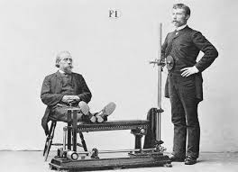
Challenge 1: Test via CQL SELECT / DSE Studio
Test your results using the three CQL SELECT statements entered on the notes page below.
The first two queries return data, the last query does not.
Notes:
SELECT col1, col2, col3 FROM t1 WHERE solr_query = '{ "q" : "col3:Dave" }' ;
SELECT col1, col2, col3 FROM t1 WHERE solr_query = '{ "q" : "col3:(Dava Rooney)" }' ;
SELECT col1, col2, col3 FROM t1 WHERE solr_query = '{ "q" : "col3:dave" }' ;

Slide 4
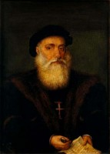
Go Farther: (Optional)
Vasco da Gama (1460-1524) First European to reach India by sea.
Source: http://totallyhistory.com/biography/famous-explorers/
Notes:
Go farther in this Practice Lab: given sample syntax, build something new.

Slide 5

Challenge 2 (Optional): Syntax to harvest from-
ALTER SEARCH INDEX SCHEMA ON t2
ADD fieldType[@name='TextField44',class='solr.TextField‘]
WITH '{"analyzer":{"tokenizer":{"class":"solr.StandardTokenizerFactory"},
"filter":{"class":"solr.LowerCaseFilterFactory"}}}';
ALTER SEARCH INDEX SCHEMA ON t2
ADD fieldType[@name='TextField41',class='solr.TextField']
WITH '{"analyzer":{"tokenizer":{"class":"solr.StandardTokenizerFactory"},
"filter":[{"class":"solr.LowerCaseFilterFactory"},
{"class":"solr.EnglishMinimalStemFilterFactory"}]}}';
Case insensitive example
Stemming example, two filter example
Notes:
Sample syntax above to harvest ideas from, and apply to the goals outlined on the page that follows.

Slide 6
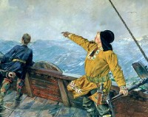
Challenge 2 (Optional): Goals
Leave col1, col2, and col3 alone. Alter col4, col5, .. as needed.
Create col4, just case insensitive.
Create col5, case insensitive, and stemming.
Create col6, case insensitive, synonym.
Experiment with forms of,
SELECT * FROM t1 WHERE col3 LIKE 'D%' ;
Leif Ericson (970-1020) Considered the first European to reach North America.
Source: http://totallyhistory.com/biography/famous-explorers/
Notes:
Additional resources:DSE Search 6.0 is based on Apache Solr (Solr) version 6.x. You can discover this from the DSE release notes and on line documentation.
The list of Solr Character (Char) Filters is available here,
https://lucene.apache.org/solr/guide/6_6/charfilterfactories.html
The list of Solr Tokenizers is available here,
https://lucene.apache.org/solr/guide/6_6/tokenizers.html
The list of Solr Filters is available here,
https://lucene.apache.org/solr/guide/6_6/filter-descriptions.html
The list of Solr unchained analyzers is here,
http://www.solr-start.com/info/analyzers/
Field Type attributes/properties (8+) :
https://lucene.apache.org/solr/guide/6_6/field-type-definitions-and-properties.html
Field attributes/properties (10+) :
https://lucene.apache.org/solr/guide/6_6/field-properties-by-use-case.html
https://lucene.apache.org/solr/guide/6_6/defining-fields.html

Slide 7
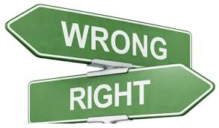
Practice Lab:
Lessons learned
Notes:
Discuss what worked well, poorly, from the Practice Lab.

Slide 8
End of Module:
Notes:
End of Practice Lab-

